Slide 1
Operating Systems and The Cloud, Part II: Search => Cluster Apps => Scalable Machine Learning
David E. Culler
CS162 – Operating Systems and Systems Programming
Lecture 40
December 3, 2014
Proj: CP 2 today
Reviews in R&R
Mid3 12/15

Slide 2
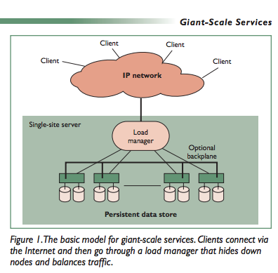
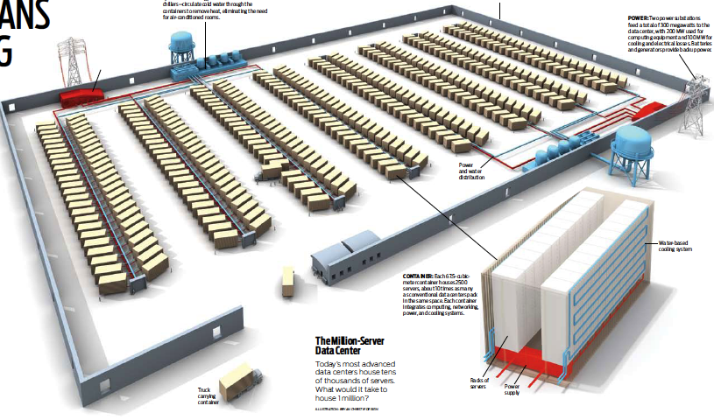
The Data Center as a System
Clusters became THE architecture for large scale internet services
Distribute disks, files, I/O, net, and compute over everything
Massive AND Incremental scalability
Search Engines the initial “Killer App”
Multiple components as Cluster Apps
Web crawl, Index, Search & Rank, Network, …
Global Layer as a Master/Worker pattern
GFS, HDFS
Map Reduce framework address core of search on massive scale – and much more
Indexing, log analysis, data querying
Collating, inverted indexes : map(k,v) => f(k,v),(k,v)
Filtering, Parsing, Validation
Sorting
Lessons from Giant-Scale Services, Eric Brewer, IEEE Computer, Jul 2001

Slide 3
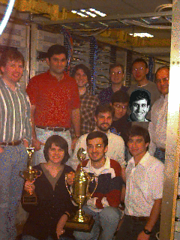
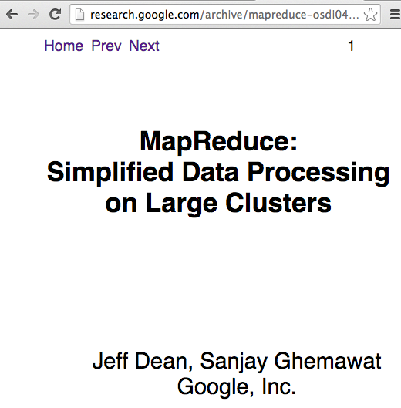

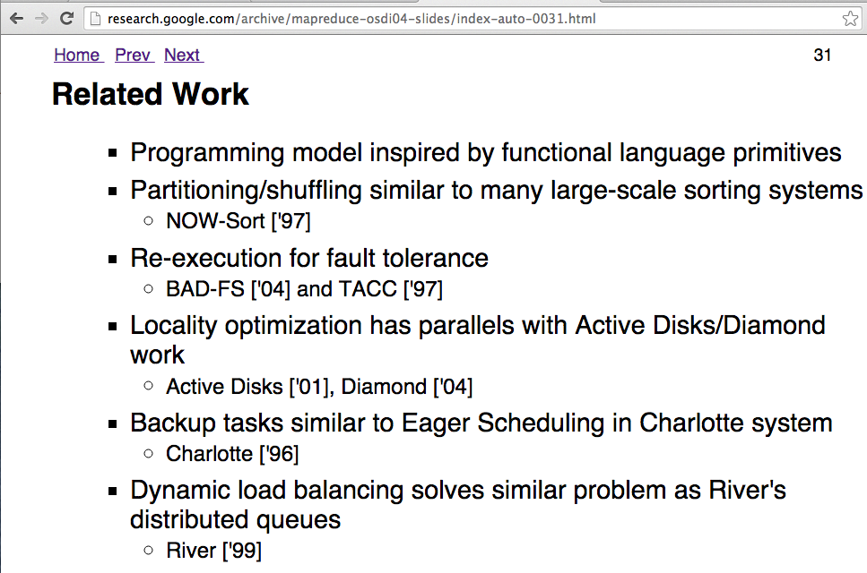

Research …

Slide 4
The Data Center as a System
Clusters became THE architecture for large scale internet services
Distribute disks, files, I/O, net, and compute over everything
Massive AND Incremental scalability
Search Engines the initial “Killer App”
Multiple components as Cluster Apps
Web crawl, Index, Search & Rank, Network, …
Global Layer as a Master/Worker pattern
GFS, HDFS
Map Reduce framework address core of search on massive scale – and much more
Indexing, log analysis, data querying
Collating, inverted indexes : map(k,v) => f(k,v),(k,v)
Filtering, Parsing, Validation
Sorting,
Graph Processing (???) – page rank,
Cross-correlation (???)
Machine Learning (???)

Slide 5
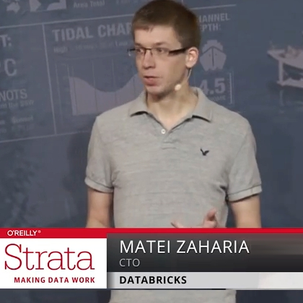
Time Travel
It’s not just storing it, it’s what you do with the data

Slide 6
Berkeley Data Analytics Stack
Cancer Genomics, Energy Debugging, Smart Buildings
In-house
Apps
BlinkDB
Sample Clean
MLBase
SparkR
Access and
Interfaces
Spark
Streaming
SparkSQL
GraphX
MLlib
Apache Spark
Velox Model Serving
Processing
Engine
Tachyon
Tachyon
Storage
HDFS, S3, …
Apache Mesos
Yarn
Resource
Virtualization

Slide 7
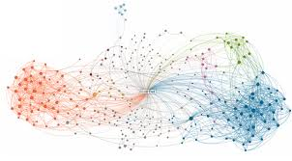
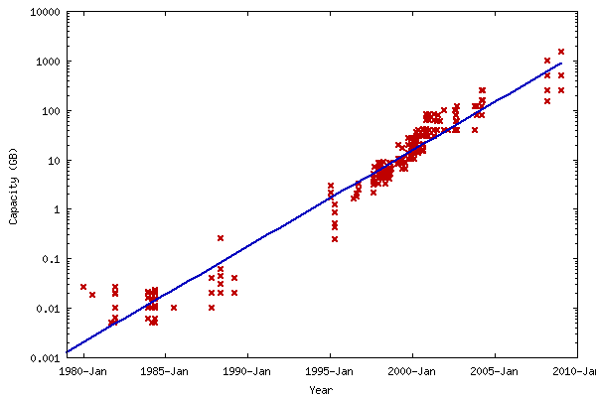
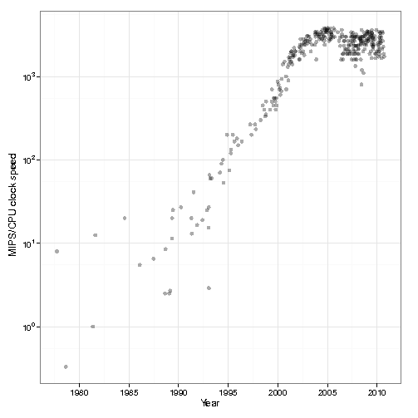
The Data Deluge
Billions of users connected through the net
WWW, Facebook, twitter, cell phones, …
80% of the data on FB was produced last year
Clock Rates stalled
Storage getting cheaper
Store more data!

Slide 8
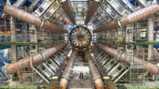

Data Grows Faster than Moore’s Law
Projected Growth
Increase over 2010

Slide 9
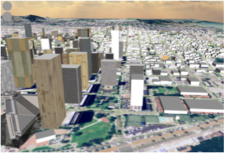
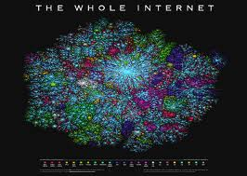
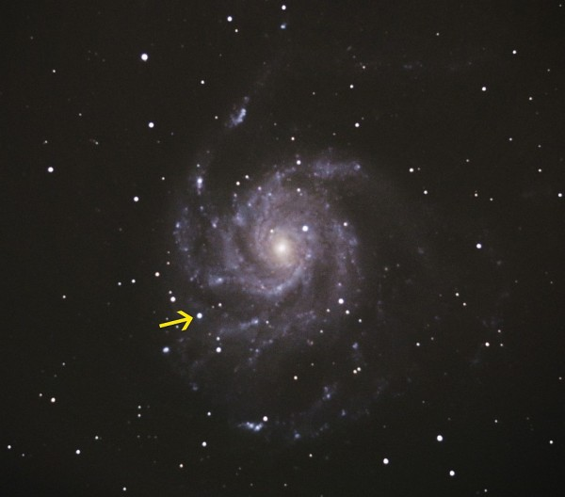
Complex Questions
Hard questions
What is the impact on traffic and home prices of building a new ramp?
Detect real-time events
Is there a cyber attack going on?
Open-ended questions
How many supernovae happened last year?
Notes:
Finally, we want to use data to ask complex questions, such as is what is the impact on traffic and home prices on building a new highway ramp.
Or we want to detect real-time events, such as is there a cyber attack qoing on?
Or we want to answer open ended questions, such as how many supernovae happened last year?

Slide 10
MapReduce Pros
Distribution is completely transparent
Not a single line of distributed programming (ease, correctness)
Automatic fault-tolerance
Determinism enables running failed tasks somewhere else again
Saved intermediate data enables just re-running failed reducers
Automatic scaling
As operations as side-effect free, they can be distributed to any number of machines dynamically
Automatic load-balancing
Move tasks and speculatively execute duplicate copies of slow tasks (stragglers)
Notes:
Transparent: not a single line of code

Slide 11

HDFS – distributed file system
Master server
manages file systems namespace
Regulates client access
Mapping to data nodes
Blocks are distributed, with replicas, across nodes
Name-node provides the index structure
Client locates blocks via RPC to metadata
Data nodes inform Namenode of failures through heartbeats
Block locations made visible to MapReduce Framework

Slide 12
MapReduce
both a programming model and a clustered computing system
A specific pattern of computing over large distributed data sets
A system which takes a MapReduce-formulated problem and executes it on a large cluster
Hides implementation details, such as hardware failures, grouping and sorting, scheduling …

Slide 13
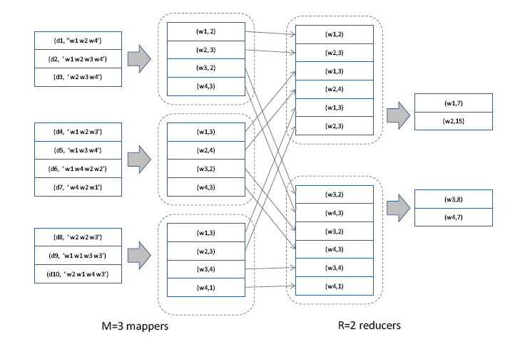
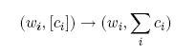
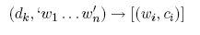
Word-Count using MapReduce
Problem: determine the frequency of each word in a large document collection

Slide 14
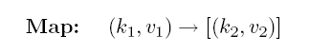
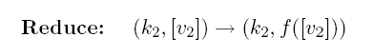
General MapReduce Formulation
Map:
Preprocesses a set of files to generate intermediate key-value pairs, in parallel
Group:
Partitions intermediate key-value pairs by unique key, generating a list of all associated values
Shuffle so each key list is all on a node
Reduce:
For each key, iterate over value list
Performs computation that requires context between iterations
Parallelizable amongst different keys, but not within one key
Notes:
A common question is: how is map reduce different from cloning the input data N ways, and using N workers to process the data using the original non-MR formulation/

Slide 15
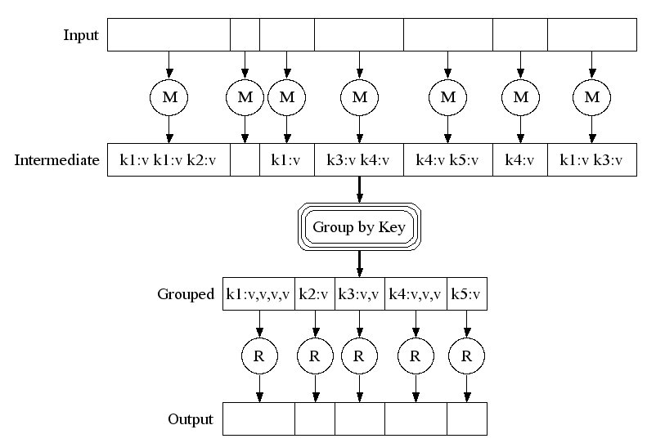
MapReduce Logical Execution

Slide 16
MapReduce Parallel Execution
Shamelessly stolen from Jeff Dean’s OSDI ‘04 presentation
http://labs.google.com/papers/mapreduce-osdi04-slides/index.html

Slide 17
MapReduce Parallelization: Pipelining
Fine grain tasks: many more map tasks than machines
Better dynamic load balancing
Minimizes time for fault recovery
Can pipeline the shuffling/grouping while maps are still running
Example: 2000 machines -> 200,000 map + 5000 reduce tasks
Shamelessly stolen from Jeff Dean’s OSDI ‘04 presentation
http://labs.google.com/papers/mapreduce-osdi04-slides/index.html

Slide 18
MR Runtime Execution Example
The following slides illustrate an example run of MapReduce on a Google cluster
A sample job from the indexing pipeline, processes ~900 GB of crawled pages

Slide 19
MR Runtime (1 of 9)
Shamelessly stolen from Jeff Dean’s OSDI ‘04 presentation
http://labs.google.com/papers/mapreduce-osdi04-slides/index.html

Slide 20
MR Runtime (2 of 9)
Shamelessly stolen from Jeff Dean’s OSDI ‘04 presentation
http://labs.google.com/papers/mapreduce-osdi04-slides/index.html

Slide 21
MR Runtime (3 of 9)
Shamelessly stolen from Jeff Dean’s OSDI ‘04 presentation
http://labs.google.com/papers/mapreduce-osdi04-slides/index.html

Slide 22
MR Runtime (4 of 9)
Shamelessly stolen from Jeff Dean’s OSDI ‘04 presentation
http://labs.google.com/papers/mapreduce-osdi04-slides/index.html

Slide 23
MR Runtime (5 of 9)
Shamelessly stolen from Jeff Dean’s OSDI ‘04 presentation
http://labs.google.com/papers/mapreduce-osdi04-slides/index.html

Slide 24
MR Runtime (6 of 9)
Shamelessly stolen from Jeff Dean’s OSDI ‘04 presentation
http://labs.google.com/papers/mapreduce-osdi04-slides/index.html

Slide 25
MR Runtime (7 of 9)
Shamelessly stolen from Jeff Dean’s OSDI ‘04 presentation
http://labs.google.com/papers/mapreduce-osdi04-slides/index.html

Slide 26
MR Runtime (8 of 9)
Shamelessly stolen from Jeff Dean’s OSDI ‘04 presentation
http://labs.google.com/papers/mapreduce-osdi04-slides/index.html

Slide 27
MR Runtime (9 of 9)
Shamelessly stolen from Jeff Dean’s OSDI ‘04 presentation
http://labs.google.com/papers/mapreduce-osdi04-slides/index.html

Slide 28
Fault Tolerance vis re-execution
On Worker Failure:
Detect via periodic heartbeats
Re-execute completed and in-progress map tasks
Re-execute in progress reduce tasks
Task completion committed through master
Master ???

Slide 29
Admin
Project 3
Reviews during R&R
Mid 3 in Final Exam Group 1 (12/15 8-11)
10 Evans (currently)

Slide 30
MapReduce Cons
Restricted programming model
Not always natural to express problems in this model
Low-level coding necessary
Little support for iterative jobs (lots of disk access)
High-latency (batch processing)
Addressed by follow-up research and Apache projects
Pig and Hive for high-level coding
Spark for iterative and low-latency jobs
Notes:
Expressitivity; can however do graph algos, even simulate other parallel models (PRAM and BSP

Slide 31
Big Data Ecosystem Evolution
Giraph
Pregel
Dremel
Drill
Tez
MapReduce
Impala
GraphLab
Storm
…
S4
General batch processing
Specialized systems
(iterative, interactive and streaming apps)

Slide 32
AMPLab Unification Philosophy
Don’t specialize MapReduce – Generalize it!
Two additions to Hadoop MR can enable all the models shown earlier!
1. General Task DAGs
2. Data Sharing
For Users:
Fewer Systems to Use
Less Data Movement
SparkSQL
Streaming
GraphX
MLbase
…
Spark

Slide 33

UCB / Apache Spark Motivation
Complex jobs, interactive queries and online processing all need one thing that MR lacks:
Efficient primitives for data sharing
Stage 1
Stage 2
Stage 3
Query 1
Job 1
Job 2
Query 2
…
Query 3
Iterative job
Interactive mining
Stream processing

Slide 34
Spark Motivation
Complex jobs, interactive queries and online processing all need one thing that MR lacks:
Efficient primitives for data sharing
Problem: in MR, the only way to share data across jobs is using stable storage (e.g. file system) ➔ slow!
Stage 1
Stage 2
Stage 3
Query 1
Job 1
Job 2
Query 2
…
Query 3
Iterative job
Interactive mining
Stream processing

Slide 35
Examples
HDFS read
HDFS write
HDFS read
HDFS write
iter. 1
iter. 2
. . .
Input
HDFS read
query 1
result 1
query 2
result 2
Opportunity: DRAM is getting cheaper ➔ use main memory for intermediate results instead of disks
query 3
result 3
Input
. . .
Notes:
Each iteration is, for example, a MapReduce job

Slide 36
Berkeley Data Analytics Stack (open source software)
Cancer Genomics, Energy Debugging, Smart Buildings
In-house
Apps
BlinkDB
Sample Clean
MLBase
SparkR
Access and
Interfaces
Spark
Streaming
SparkSQL
GraphX
MLlib
Apache Spark
Velox Model Serving
Processing
Engine
Tachyon
Tachyon
Storage
HDFS, S3, …
Apache Mesos
Yarn
Resource
Virtualization

Slide 37

“It’s only September but it’s already clear that 2014 will be the year of Apache Spark”
-- Datanami, 9/15/14
In-Memory
Dataflow
System
M. Zaharia, M. Choudhury, M. Franklin, I. Stoica, S. Shenker, “Spark: Cluster Computing with Working Sets, USENIX HotCloud, 2010.

Slide 38
Iteration in Map-Reduce
Initial
Model
Learned
Model
Map
Reduce
w⁽⁰⁾
w⁽¹⁾
Training
Data
w⁽²⁾
w⁽³⁾

Slide 39
Cost of Iteration in Map-Reduce
Initial
Model
Learned
Model
Map
Reduce
w⁽⁰⁾
w⁽¹⁾
Read 1
Training
Data
Repeatedly load same data
Read 2
w⁽²⁾
Read 3
w⁽³⁾

Slide 40
Cost of Iteration in Map-Reduce
Initial
Model
Learned
Model
Map
Reduce
w⁽⁰⁾
w⁽¹⁾
Training
Data
Redundantly save output between stages
w⁽²⁾
w⁽³⁾

Slide 41
Dataflow View
Map
Reduce
Training Data
(HDFS)
Map
Reduce
Map
Reduce

Slide 42
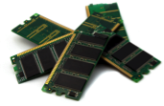
Memory Opt. Dataflow
Map
Reduce
Cached
Load
Training Data
(HDFS)
Map
Reduce
Map
Reduce

Slide 43
Memory Opt. Dataflow View
Map
Reduce
Efficiently move data
between stages
Training Data
(HDFS)
Map
Reduce
Map
Reduce
Spark:10-100× faster than Hadoop MapReduce

Slide 44
Resilient Distributed Datasets (RDDs)
API: coarse-grained transformations (map, group-by, join, sort, filter, sample,…) on immutable collections
Resilient Distributed Datasets (RDDs)
Collections of objects that can be stored in memory or disk across a cluster
Built via parallel transformations (map, filter, …)
Automatically rebuilt on failure
Rich enough to capture many models:
Data flow models: MapReduce, Dryad, SQL, …
Specialized models: Pregel, Hama, …
M. Zaharia, et al, Resilient Distributed Datasets: A fault-tolerant abstraction for in-memory cluster computing, NSDI 2012.

Slide 45
Fault Tolerance with RDDs
RDDs track the series of transformations used to build them (their lineage)
Log one operation to apply to many elements
No cost if nothing fails
Enables per-node recomputation of lost data
messages = textFile(...).filter(_.contains(“error”))
.map(_.split(‘\t’)(2))
HadoopRDD
path = hdfs://…
FilteredRDD
func = _.contains(...)
MappedRDD
func = _.split(…)

Slide 46
Systems Research as Time Travel …
Cancer Genomics, Energy Debugging, Smart Buildings
In-house
Apps
BlinkDB
Sample Clean
MLBase
SparkR
Access and
Interfaces
Spark
Streaming
SparkSQL
GraphX
MLlib
Apache Spark
Velox Model Serving
Processing
Engine
Tachyon
Tachyon
Storage
HDFS, S3, …
Apache Mesos
Yarn
Resource
Virtualization

